Slide 1


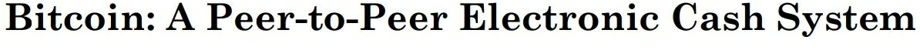
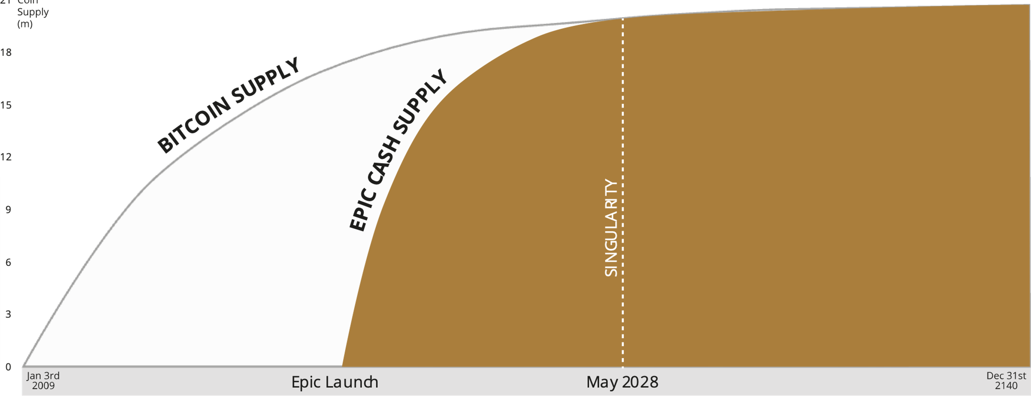
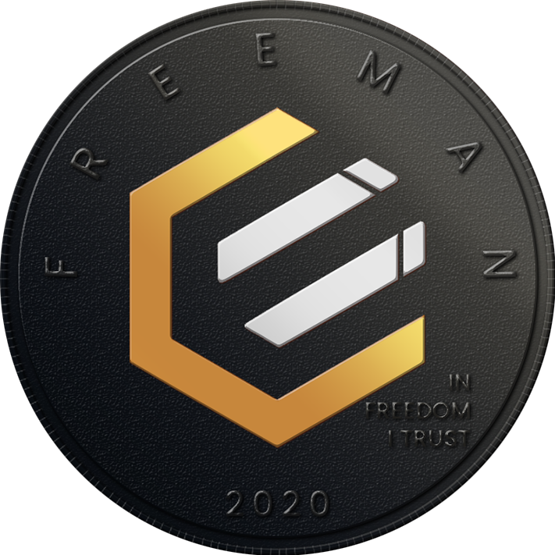

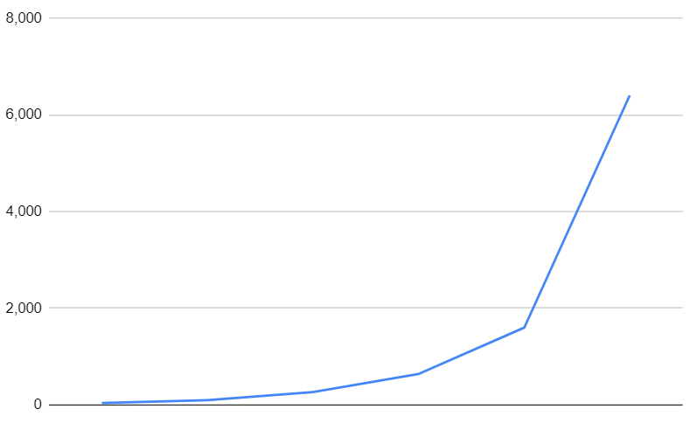
SCARCITY
21MM
4% ASIC
48% GPU
48% CPU
Polyphasic Proof-of-Work
Eco-friendly
Future-proofed
Quantum-ready
Scalable
BTC
EPIC
DOES YOUR BITCOIN RELY ON TRUST?
ANONYMOUS & PRIVATE
BORDERLESS
IMMUTABLE
PERMISSIONLESS
PUBLIC
TRUSTLESS
LIGHTNING NETWORK
DECENTRALIZED
Genesis Block | 2009 | 2019
Genesis Supply | 0 | 0
2140 Supply | 21MM | 21MM
2028 Supply | 20.3MM | 20.3MM
2022 Supply | 18.9MM | 13.9MM
ASIC mined | 100% | 4%
Fungibility | No | Yes
Anonymous + Private | No | Yes
Borderless | No | Yes
Centralization Resistant | No | Yes
Confiscation Resistant | No | Yes
Surveillance Resistant | No | Yes
Speed | 10 min | 1 min
Cost | $2-$81 | $0.01
Block Size | 1MB | 1MB
L1 Throughput 2028 | 4 tx/s | 6,400 tx/s
DISTRIBUTED
Blocks/Day
2
Block Size (MB)
128
EPIC THROUGHPUT

